Slide 1


Status Report TTbar resonances Angular Distributions NTUA
George Bakas

Slide 2

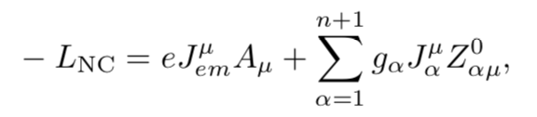
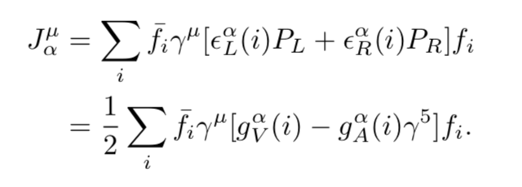
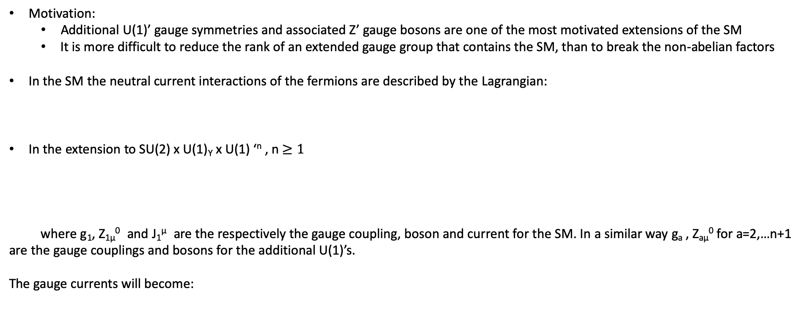
Z prime physics
Motivation:
Additional U(1)’ gauge symmetries and associated Z’ gauge bosons are one of the most motivated extensions of the SM
It is more difficult to reduce the rank of an extended gauge group that contains the SM, than to break the non-abelian factors
In the SM the neutral current interactions of the fermions are described by the Lagrangian:
In the extension to SU(2) x U(1)_{Y} x U(1) ‘^{n} , n $≥1$
where g₁, Z_{1μ}⁰ and J₁^{μ} are the respectively the gauge coupling, boson and current for the SM. In a similar way g_{a} , Z_{aμ}⁰ for a=2,…n+1 are the gauge couplings and bosons for the additional U(1)’s.
The gauge currents will become:

Slide 3



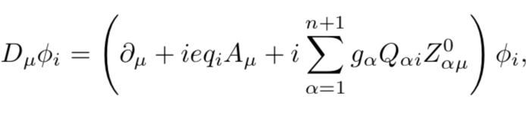
Z prime physics
The chiral couplings e_{L} , e_{R} are the U(1)_{a} charges of the left and right handed components of the fermions and g_{V,A} = e_{L} ± e_{R} are the corresponding vector and axial couplings
It is more convenient to specify the charges of the left chiral components of both the fermion f and the antifermion f^{c} with Q_{af} , Q_{afc} :
For example in the SM one has: and
The additional gauge couplings and charges are extremely model dependent
The gauge covariant derivative will become:
Where the q_{i} , Q_{ai} , are respectively the electric and U(1)_{a} charges of the φ_{i}

Slide 4


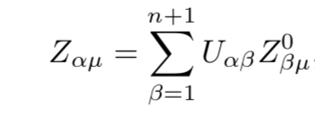

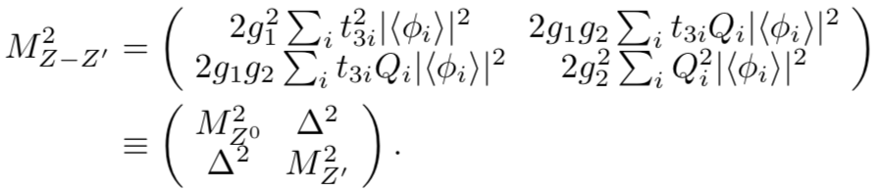
Z prime physics-Masses and mass mixings
We assume that the electrically neutral photon field is massless while the Z_{aμ}⁰ develops a mass term
Where
Diagonilize the mass matrix and one obtains n+1 massive eigenstates Zαμ with mass M_{α} :
But Z_{aμ} couples to and the most studied case is where n =1 and we get a mass matrix:

Slide 5
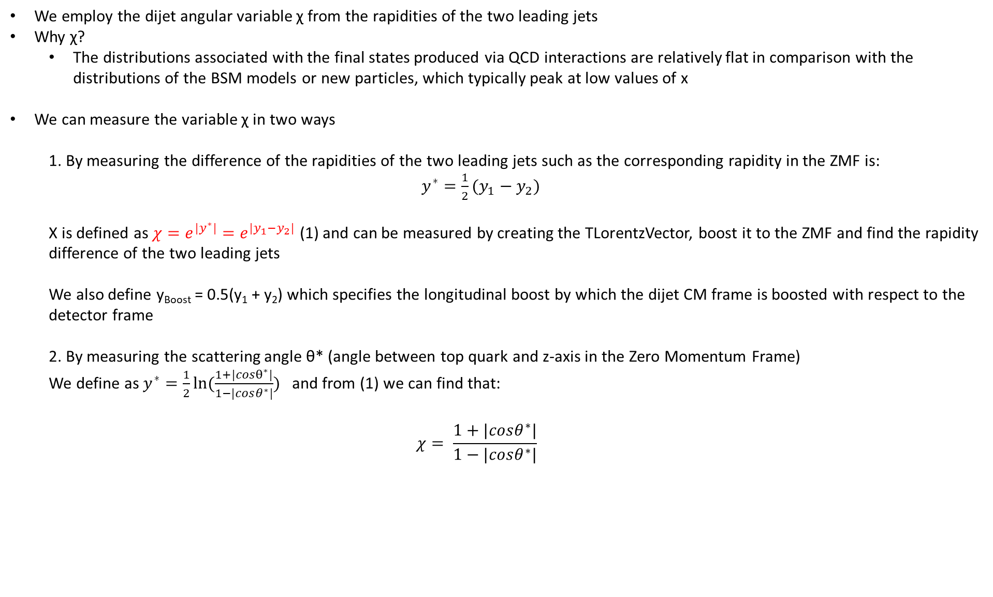
Variables
We employ the dijet angular variable χ from the rapidities of the two leading jets
Why χ?
The distributions associated with the final states produced via QCD interactions are relatively flat in comparison with the distributions of the BSM models or new particles, which typically peak at low values of x
We can measure the variable χ in two ways
1. By measuring the difference of the rapidities of the two leading jets such as the corresponding rapidity in the ZMF is: $y^{∗}=\frac{1}{2}(y_{1}−y_{2})$
Χ is defined as $χ=e^{{|y}^{∗}|}=e^{|y_{1}−y_{2}|}$ (1) and can be measured by creating the TLorentzVector, boost it to the ZMF and find the rapidity difference of the two leading jets
We also define y_{Boost} = 0.5(y₁ + y₂) which specifies the longitudinal boost by which the dijet CM frame is boosted with respect to the detector frame
2. By measuring the scattering angle θ* (angle between top quark and z-axis in the Zero Momentum Frame)
We define as $y^{∗}=\frac{1}{2}ln⁡(\frac{1+|cosθ^{∗}|}{1−|cosθ^{∗}|})$ and from (1) we can find that:
$$χ= \frac{1+|cosθ^{∗}|}{1−|cosθ^{∗}|}$$

Slide 6
Response Matrices
Selection:
Parton: partonPt > 500*, |partonEta|< 2.4, mTTbarParton > 1000
Reco: jetPt>500, |jetEta| < 2.4, nLeptons ==0
Btagging Medium working point
Top tagger mva > 0.3
Jet mass soft Drop (120, 220)GeV
Jets are matched
Response matrix of χ_{reco}, χ_{parton} with {1,2,3,4,5,6,8,10,13,16} as variable binning
The same binning is then used to find the response matrices in different mass (mTTbar) regions
[1000-1600]GeV
[1600-2200]GeV
[2200-3000]GeV
[3000-3600]GeV
[3600-6000]GeV
Stability, Efficiency for χ distribution
Acceptance and purity for χ
*By applying the Pt to be more than 500, we get more similar results with ATLAS

Slide 7
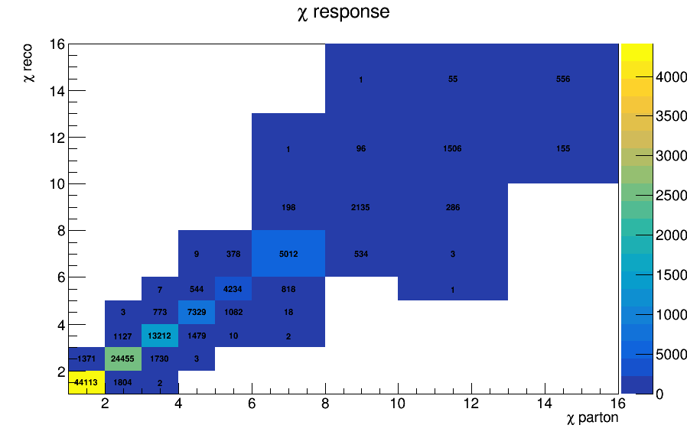
Response Matrix for χ

Slide 8
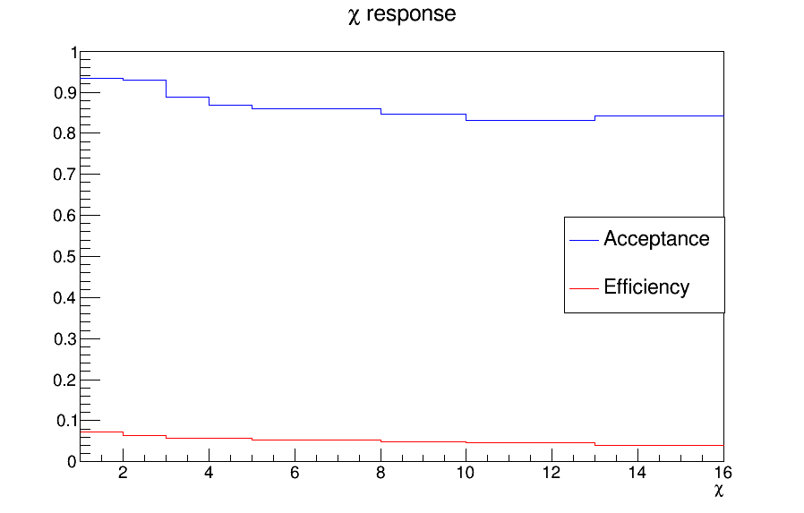
Efficiency and Acceptance for chi distribution

Slide 9
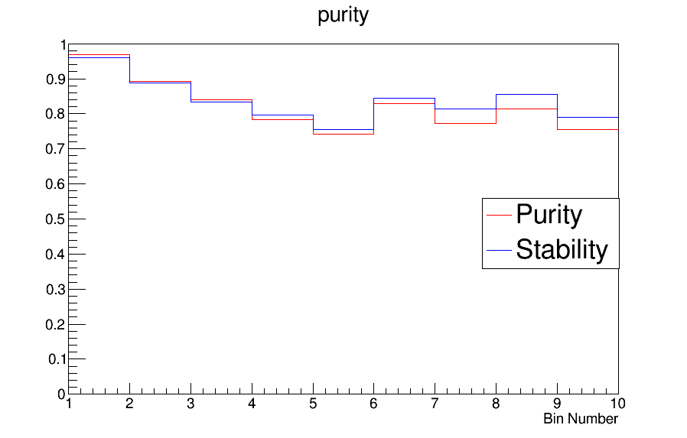
Purity and Stability for chi distribution

Slide 10
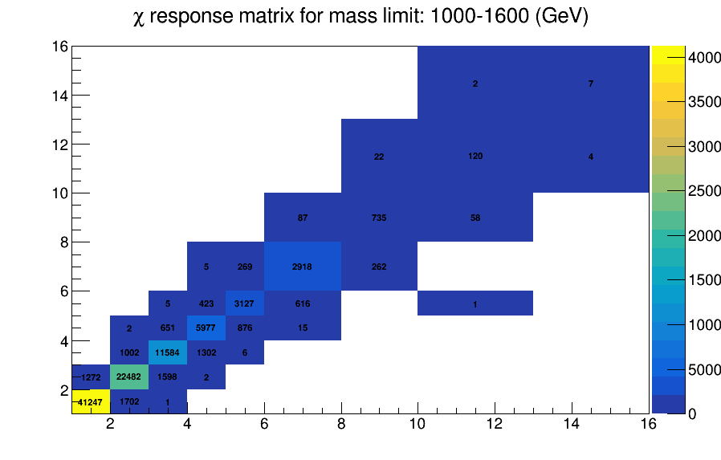
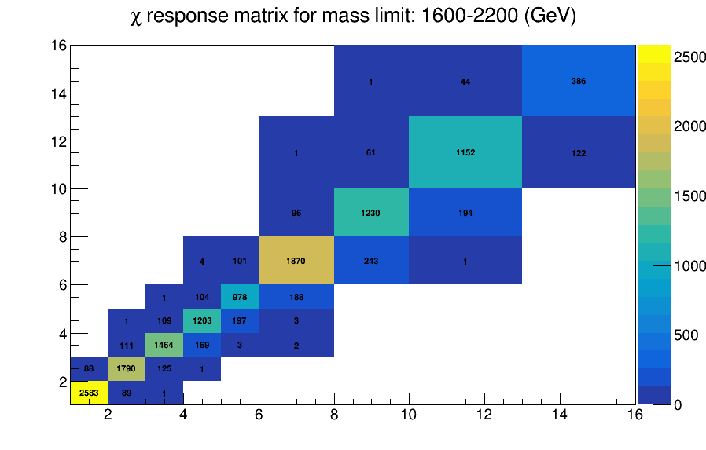

Slide 11
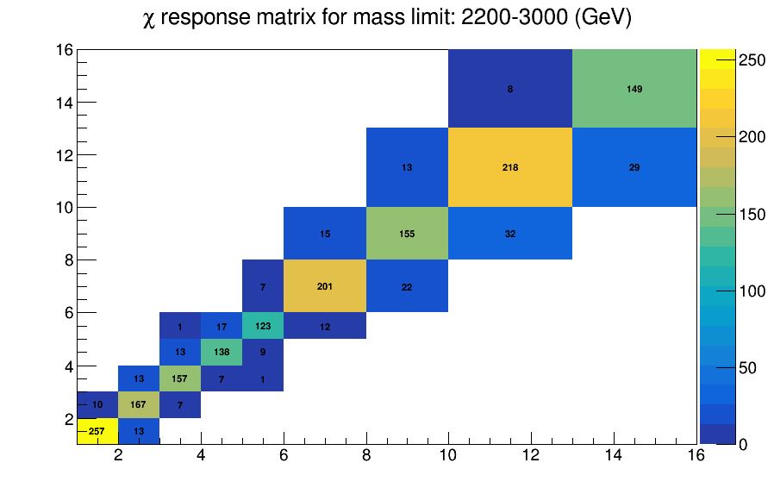
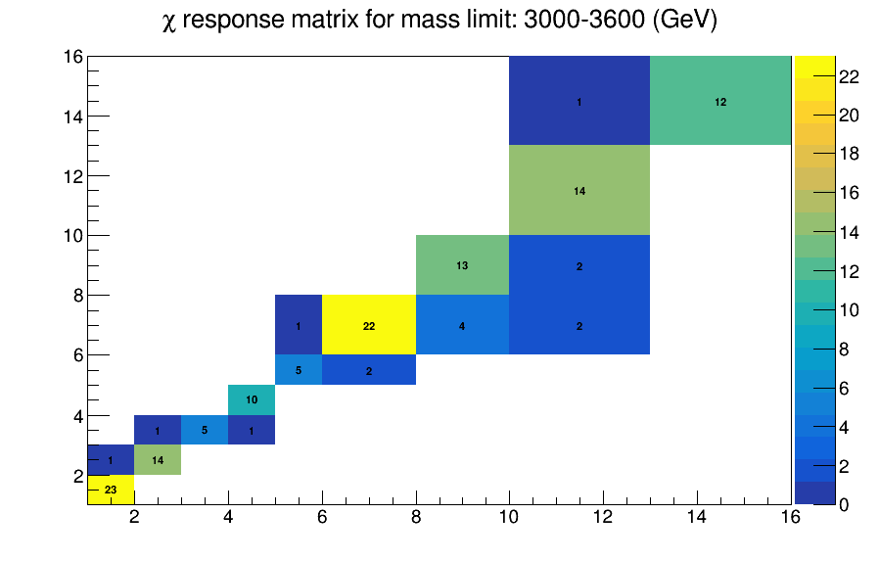

Slide 12
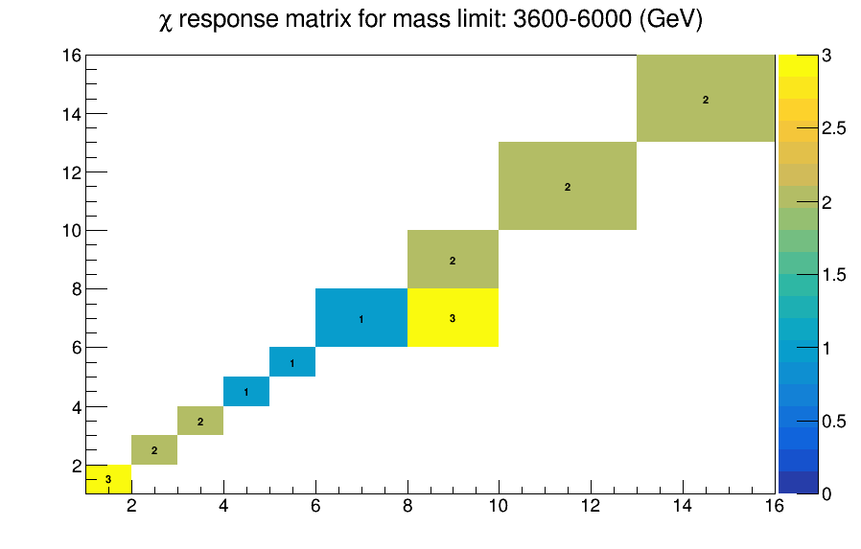

Slide 13
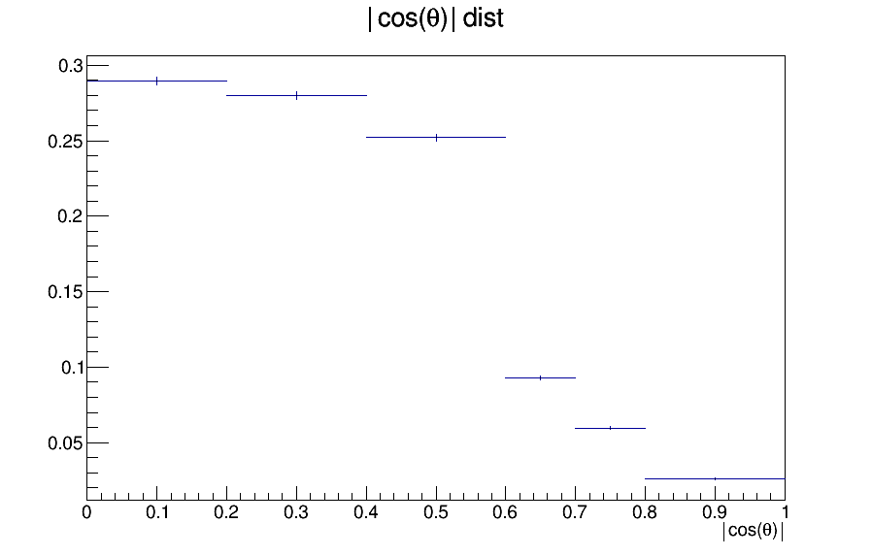
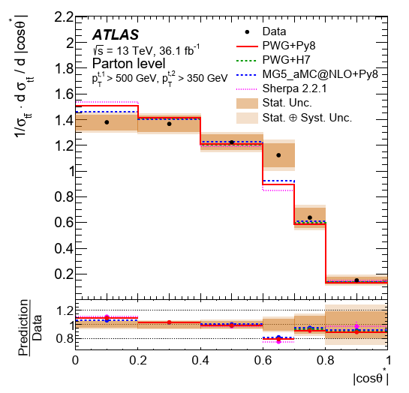
Comparisons with ATLAS |cosθ| distributions

Slide 14
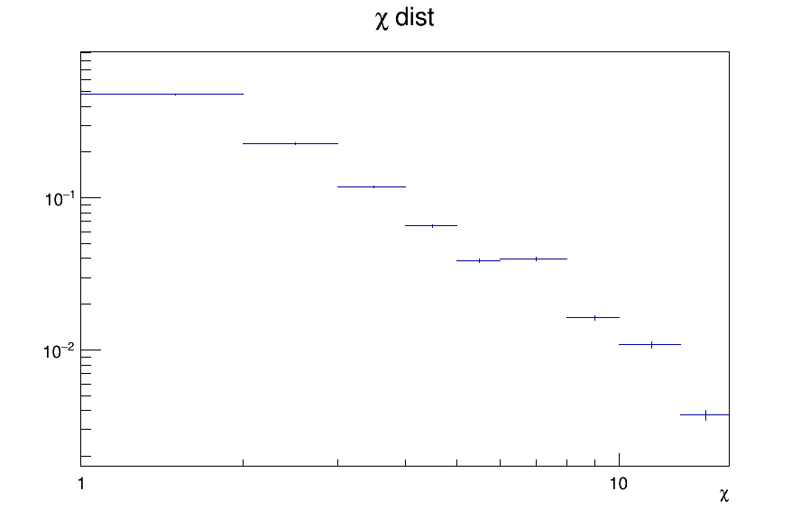
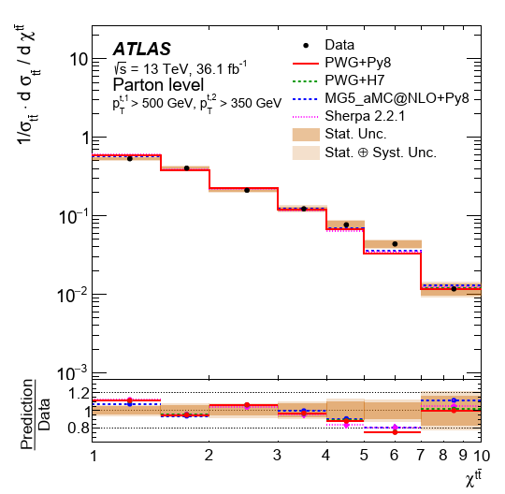
Comparisons with ATLAS χ distributions

Slide 15
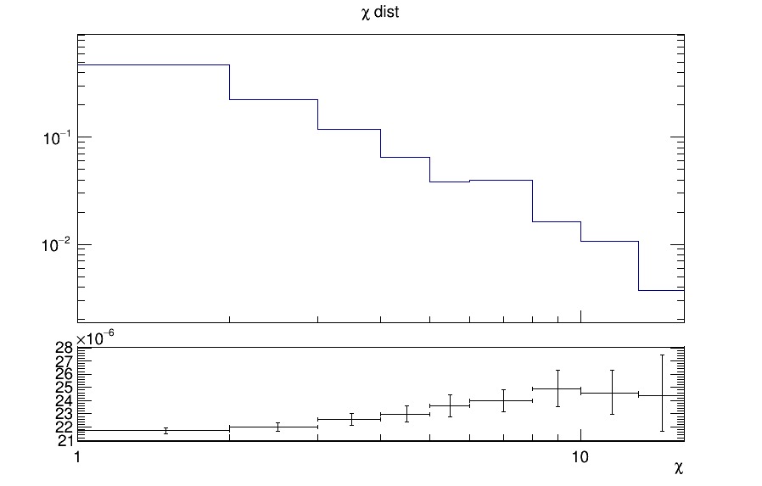

Comparison on how to measure x value
$e^{\left|2y^{∗}\right|}$
$χ= \frac{1+|cosθ^{∗}|}{1−|cosθ^{∗}|}$
No difference

Slide 16
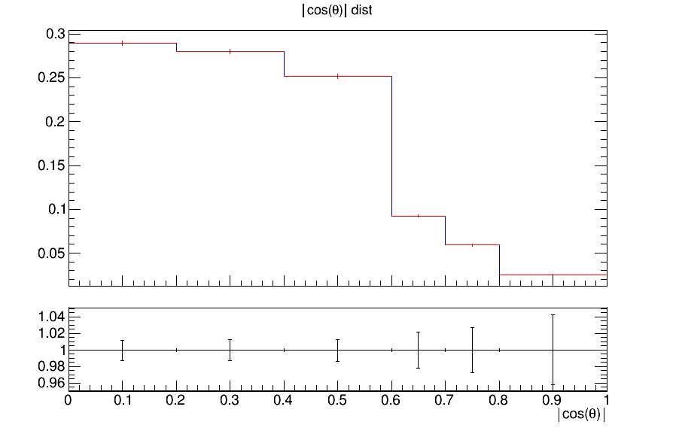
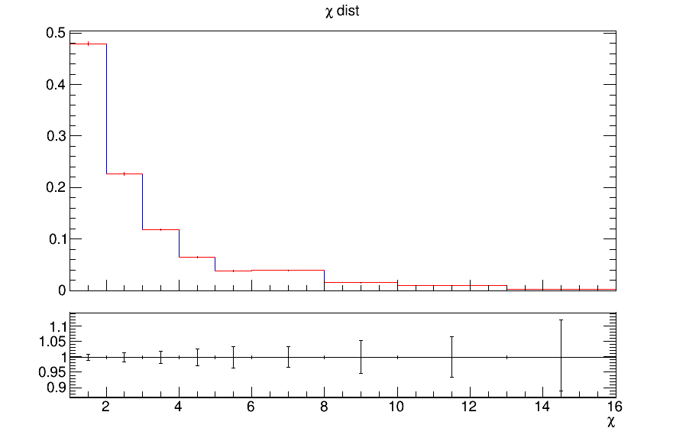
QCD Measurement vs Search
In exotica searches, an |y_{Boost}|<1.19 cut is applied
Are there any differences when we don’t aply the cut?
|cosθ| With boost cut
χ With boost cut
|cosθ|
χ

